Slide 1
Docker

Slide 2
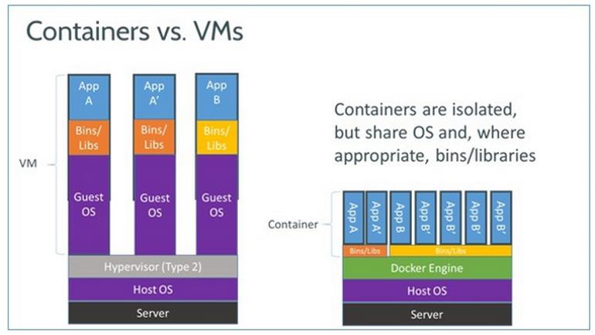
Containers
More lightweight than VMs
Can run many more containers than VMs
Keep dev/stage/prod environments as similar as possible
Bundle apps with their dependencies
Isolate apps from host and each other
Easy to share application stacks
Easy to spin up and take down as compared to in a VM

Slide 3
Build Arguments
Arguments that can be consumed in the context of the Dockerfile
Available during build-time
Not persisted in the built image unlike ENV vars
In multi-stage builds, goes out of scope at the end of the build stage

Slide 4
.dockerignore file
Help reduce docker image size and speeds up the build
Specify list of files and/or directories which you might want to ignore while building the image
Build context – files that are packed and sent to the docker server when building the image.
Specified when using the docker build command

Slide 5

Layers & build cache
Layers can be re-used by multiple images saving disk space
Also reduces time to build images
Each container is an image with a readable/writeable layer on top of a bunch of read-only layers.
Order the steps in the Dockerfile from the less frequently changed to the more frequently changed.

Slide 6
Volumes
By default, data isn’t persisted
Volumes are file systems mounts on containers to persist data.
Use cases:
Persist data when the container is removed (ex: logs)
Share data among multiple containers
Store data on a remote host
Local development

Slide 7
Environment Variables
Separates services from their configuration
This is also one of the factors in the Twelve-factor app
Env vars are available in running containers
Values can be viewed using docker inspect
Should not be used for sensitive information

Slide 8

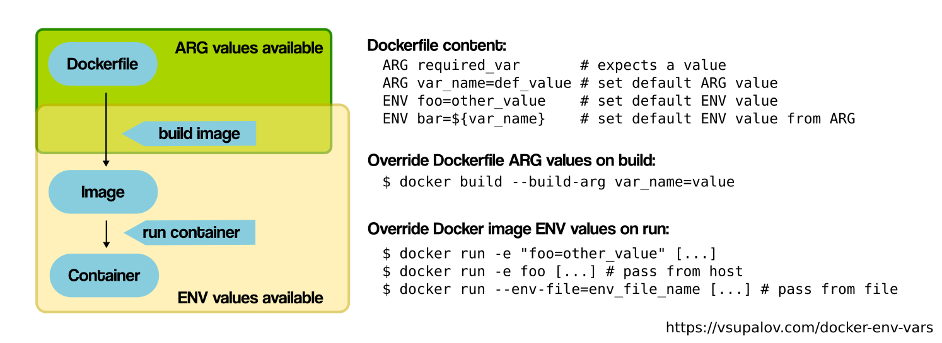



ARG vs ENV

Slide 9
Docker Compose
Tool to configure multiple containers and dependencies together as a single service.
Use YAML file to configure services
Start all services with a single command
Use cases:
Isolated development environment
Automated testing environments

Slide 10
Docker Compose
Tool to configure multiple containers and dependencies together as a single service.
Use YAML file to configure services
Start all services with a single command
Use cases:
Isolated development environment
Automated testing environments

